Slide 1
Sprint 3
Capstone Project
Alternative Fuel Stations and Electric Vehicles Study
Michael Dorado
BrainStation Data Science Bootcamp
May 5th, 2024

Slide 2
Project Overview
According to a survey from 2022, 46% of U.S. consumers are concerned about the limited availability of public charging stations for EV.
European countries are preparing to ban the sales of new gas-powered vehicles by 2035.
Using Linear Regression and/or Time Series Forecasting, consumers could make data driven decisions.
Motivation
Vision
Solution

Slide 3




Dataset Overview
www.data.gov
Original dataframe shape (56800, 65)
Modeling dataframe shape (316, 1)
Published by the National Renewable Energy Laboratory on July 31st, 2021.

Slide 4
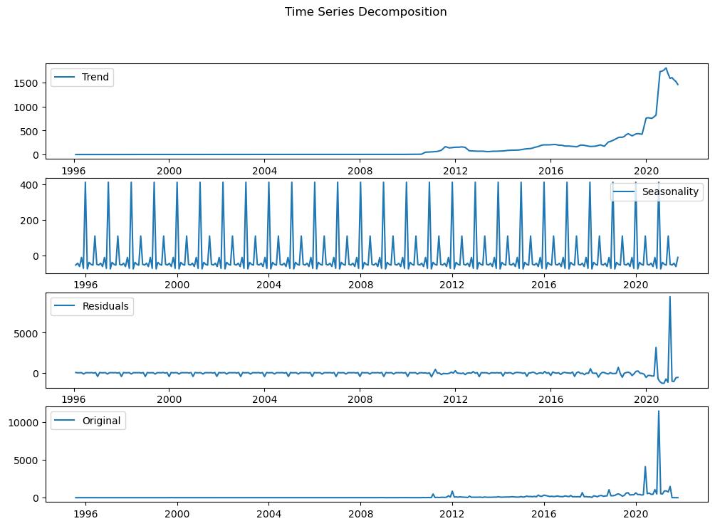
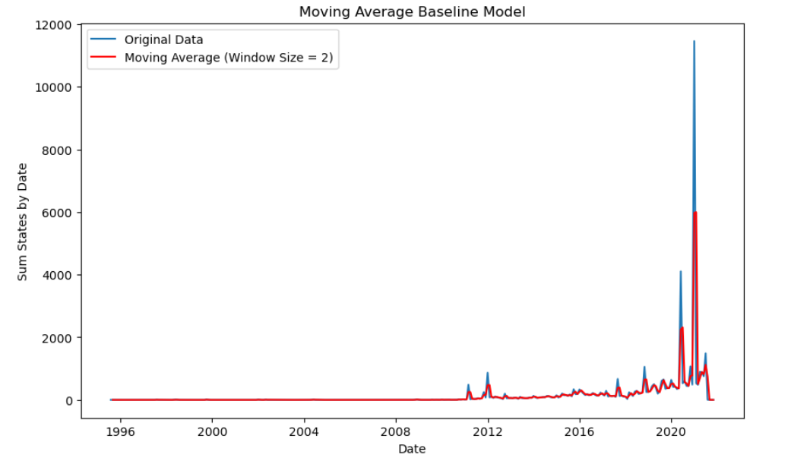
Important EDA Findings & Baseline Model
Trend is positive.
Seasonality is highest during January and June.
Residual shows slight seasonality, notable variance at the end.
Data is non-stationary, its statistical properties, such as mean and variance, change over time.
Rolling Moving Average with a 2-month window was used for the Baseline.
Mean % Error = -132.92%
Underestimates the original data
2-month window size provides finer granularity and sensitivity variations in the data.

Slide 5
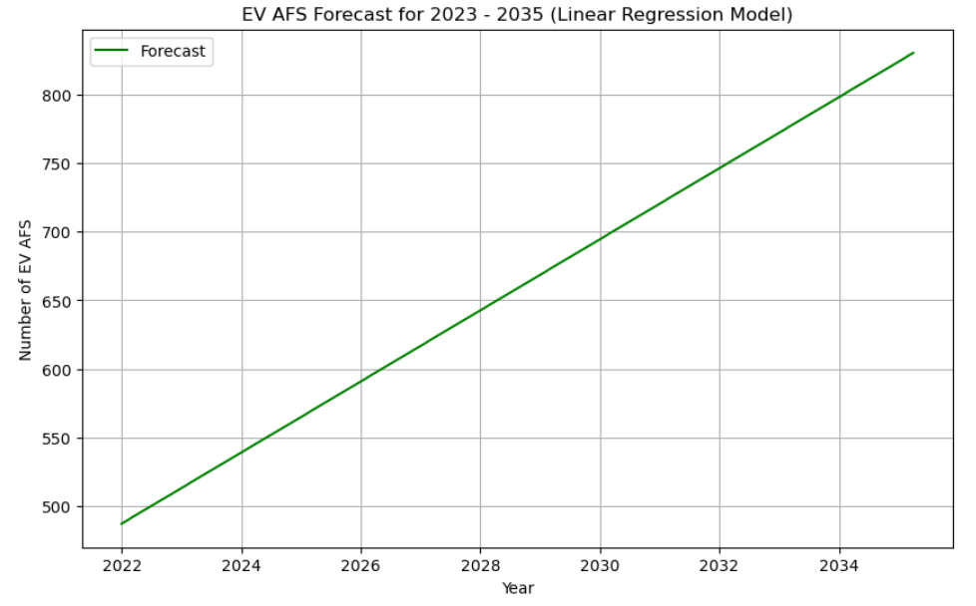
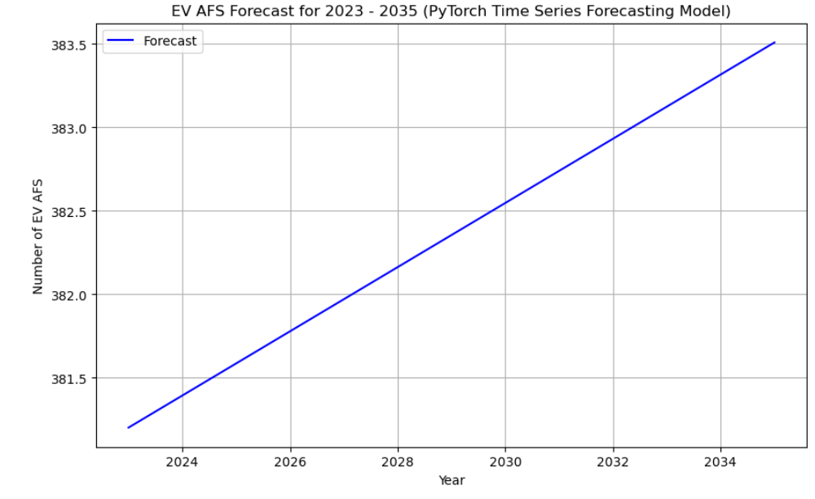
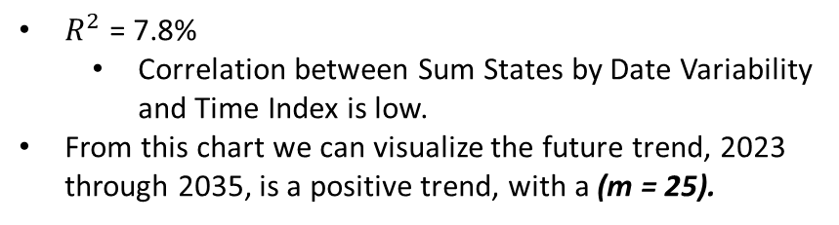
Modeling
Linear Regression Model
PyTorch Time Series Forecasting
$R^{2}$ = 7.8%
Correlation between Sum States by Date Variability and Time Index is low.
From this chart we can visualize the future trend, 2023 through 2035, is a positive trend, with a (m = 25).
The Mean Squared Error (MSE) on the testing data was approximately 213125136, significant discrepancy.
From this chart we can visualize the trend of the number of predicted AFS over the years 2023 through 2035. It is a positive with a (m = 0.1).

Slide 6
Additional Findings
 | Vehicles by 2022 | Vehicles by 2035 | % Change | Number of Stations | Vehicles per Station (2022) | Fill-up/Charge Up Time
Gas Powered Vehicles | 270 million (approximately) | 250 million (rough estimate) | -11.11% | 150,000 | 1,800 vehicles per 1 gas station | 5 min (6 gas powered vehicles for every 1 EV)
Electric Vehicles | 2.5 million (approximately) | 40 million (rough estimate) | +1,500% | 57,200 | 43 vehicles per 1 EV station | 30 min (1 EV for every 6 gas powered vehicle)
Consider:
For each EV charged, there are 6 gas powered vehicles fueled
EV market in the US expected to grow 1,500% by the year 2035
Although the current ratio of EV per EV Station is better than the gas powered vehicle infrastructure (even with the turnaround factored in), to maintain a healthy ratio, the growth of EV stations would have to grow by at least 130% to keep a 300 EV per 1 EV station ratio.

Slide 7
Conclusion
Findings
Charging stations infrastructure must have a yearly rate of change of ~6.5% to keep a healthy vehicles to charging stations infrastructure ratio.
Model
Linear regression slope = 25
Conclusion
EV Consumers would face charging stations infrastructure challenges.
Considerations
Keep in mind my dataset has reliability opportunities.
low R^2, high p-value, not a proper MSE.
Pytorch Time Series Forecast slope = 0.1

